Slide 1
CS 499/CS 579: Enterprise Defense
Day 3: Network Domain

Slide 2

Domains

Slide 3
Domains… Why?
Enterprise / server environments can get complex quickly
At scale, need a way to…
Dictate policies
Authenticate and authorize users
Control machines
Secure them
Notes:
Remember the complex network diagram from last class
From business side of things, want to reduce expenses and sysadmins are expensive
From sysadmin side, want to be efficient ("lazy")

Slide 4
What is a Domain?
An administrative grouping of machines and networks
Allows for…
Policy administration
User access control
System administration
Security
Notes:
Policies – settings (can they watch youtube, can they download software, can they change their desktop settings?)
Users – access permissions
Machines – updates, upgrades, installs, configurations
Security – settings, firewall, and hardening

Slide 5
Domains Are Everywhere
Domains are identified by their domain name
For DNS to put it on the internet, has to be unique
Fully Qualified Domain Name (FQDN)
www.google.com
engineering.oregonstate.edu
Notes:
- first off, you’ve seen domains everywhere
- you can have internal domains,
A fully qualified domain name (FQDN) is a domain name that is completely specified with all labels in the hierarchy of the DNS, having no parts omitted
Example 1
www.google.com
Read it from right to left.
First is “.com“, which is the Top-Level Domain (TLD).
Then the domain name “google“
last is the hostname “www.“
The hostname can show a specific service or protocol for the domain like “mail” or “ftp”
Example 2
https://engineering.oregonstate.edu
.edu is TLD
Oregonstate is the domain name
Engineering is the hostname

Slide 6
FQDN != URL
FQDN is a domain name within DNS hierarchy
URL is the location of a specific resource
Protocol
FQDN
Path
Parameters
Notes:
Just cause we can, a brief tangent…
A Fully Qualified Domain Name is not a Unified Resource Locator
Some overlap, but two are distinct
FQDN represents a complete and precise domain name, providing an exact location in the Domain Name System (DNS) hierarchy
This includes the top-level domain and all subordinate levels.
URL is a comprehensive descriptor for locating a specific resource on the internet.
includes the protocol (e.g., HTTP/HTTPS),
the FQDN, and
additional components like resource path and query parameters.

Slide 7
How to Control a Domain
Easy!
Just use a domain controller, duh!

Slide 8
Domain Controller

Slide 9
Domain Controllers (DC)
DCs are the servers in charge of domain
Main role is authentication and authorization
LDAP
Network time service
Network authentication protocol
Way to administer permissions and policies
Can perform other roles as well
Public key infrastructure, DNS, etc.
Several implementations exist
Notes:
Domain controller administers the network
Core duty is to be an authoritative user directory, responding to authentication and access requests for services and applications as deemed by its security policy
This doesn’t just apply to human users, the DC also handles machine accounts within the network
Allows for users to access any domain joined machine, assuming they have permissions for it
To do this, domain controller usually has some form of the following
LDAP
Network time service
Computer network authentication protocol
Way to administer permissions and policies
Can do other things
Public key infrastructure
DNS
Fax
DHCP
Web server
FTP
Several implementations of domain controllers
Microsoft’s Active Directory or AD
FreeIPA
Apple OpenDirectory
Samba
A good assumption, if you hear us talking about a DC, it’s probably a general thing DCs can do or we’re talking about AD specifically

Slide 10
Lightweight Directory Access Protocol (LDAP)
Protocol for managing user and group membership
Provides common language for services to communicate with
Industry standard
For AD, LDAP reads from AD’s user information
Not very secure
Does not support encryption by default
Integrates with other protocols for authentication
Notes:
Just a common language for directory services and applications to communicate in while
For AD: LDAP is a language to talk to directory services, and Active Directory is one such directory service

Slide 11
Network Authentication Protocol
Great that you have a database of users
But. Still need to authenticate them
Cryptographic protocol for transferring authentication information
Many implementations
PAP, EAP, NTLM
… Kerberos
Notes:
Network auth protocol is used to manage credentials securely (authentication)
LDAP is used for holding authoritative information about the accounts, such as what they're allowed to access (authorization), the user's full name and uid
PAP - Password Authentication Protocol, a password-based authentication protocol, unencrypted
EAP - Extensible Authentication Protocol, EAP is an authentication framework, not a specific authentication mechanism
NTLM - New Technology LAN Manager, challenge–response authentication protocol, NTLM are easy to brute force

Slide 12
Word of the Day
schadenfreude
/ˈSHädənˌfroidə/
noun
“pleasure derived by someone from another person's misfortune.”
Notes:
So.
Within a Kerberos environment, if a user wants access to a service, this is what happens...

Slide 13
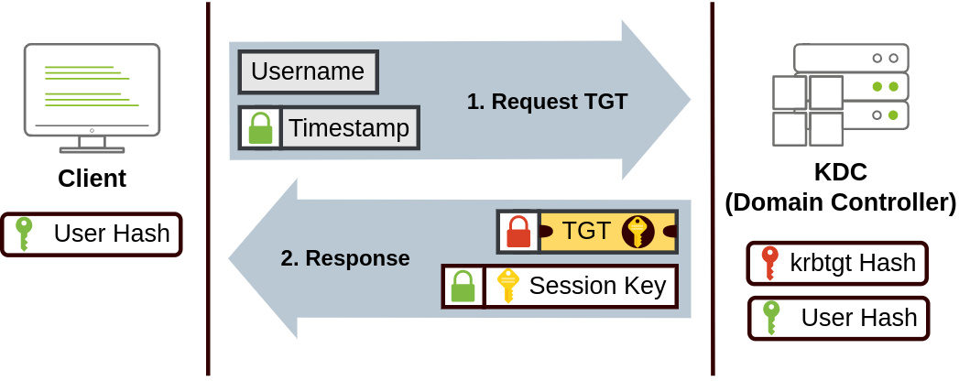
Kerberos: The Madness
Images courtesy of TryHackMe
Notes:
# Joke explanation
When a user wants access to a service, they send a ticket granting ticket (TGT) request to the key distribution center (KDC)
If approved, the KDC creates and sends back a TGT and a session key
Now, the user can request tickets to a specific service
# Actual explanation
1. “User requests Ticket Granting Ticket (TGT)”
a) User sends username & timestamp to Key Distribution Center (KDC), which is in charge of creating Kerberos tickets on network
b) timestamp is encrypted using key derived from password
2. “KDC returns TGT”
a) KDC creates and sends back TGT and Session Key
b) TGT is encrypted with user:krbtgt’s password hash
c) User can now request tickets to access a specific service, without passing creds to service

Slide 14
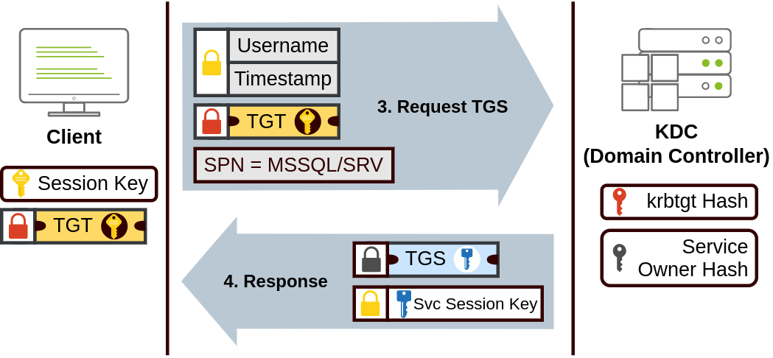
Ǩ̷̨̛̳͙̲̗̈́̓e̷̺̮͔̓̾͋̚r̸͕̹̝̞͛̈́b̷̳̾̔͝ḛ̶̢̢̦̈́͗͛͝ͅr̶̛͕͓̱̥̾͐̅͗o̷͉̦̫͆́͋͝͝ͅs̸̮̯̓:̶͙̣͊͒̄ ̵͔̃͊͝T̶̛͎͇̎̓̽h̵̲̩͑͛ͅe̵̡͇͋͛̕͝ͅ ̷̫͚͙͝M̸̰̤̝̲̑̒̒̕͠a̵̟̫̯̎̀ḑ̶͇̼͉̙̾̇̈́̆́n̶̦̊͋͋è̵͓̭̣̙̟̏͂s̶̤͖͖̐s̵͖̠̣̃̅
Images courtesy of TryHackMe
Notes:
# Joke explanation
So, the users requests access to a service through the Ticket Granting Service (TGS)
AKA they use the TGT to ask the KDC for a TGS
If approved, the KDC returns the TGS and a service session key
# Actual explanation
3. “User wants to access a service… AKA use TGT to ask KDC for TGS”
a) User wants to request Ticket Granting Service, a ticket that allows connection to only a specific service
b) User sends username and timestamp (encrypted with session key), TGT, and requested service
4. “KDC returns TGS and Service Session Key”
a) If granted, KDC replies
b) Returns TGS (encrypted with Service Owner Hash and containing a copy of the Service Session Key)
c) User can now pass this to service

Slide 15
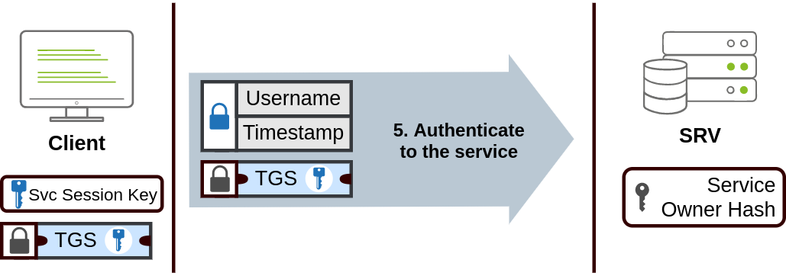
K̶̨̯̓̎̅́̎̽̈́͆͜͝ȩ̸͕̪̒͛r̷̩̀̿̅̃͠b̴̡̬̪̻͌̀͊̐̇͆̐͝ę̷̛͖̤̯͌̌͗̀͆r̷̭̻̞͛͊̐̿̏̂̿͝o̸̱͈̦͖͌̓̐̈̀̿͆̏s̸̡̛̜͕͈̳̫̪̘͆̔́̉͐̕:̷̡̦̟̜̖͂͋ ̸͉̩̩̺̝͇͐̇̌͂͆̕͠T̵̢̻̩̱̼̜̮̉͂́͑̅̔̀͆h̷͓̟̓̃͐è̵͓͈̣̩̱̽ ̴̤̘̽͗͂̋̉M̶̧̱̜̪͇͇̌́̅̒͘a̷̘̣͔̔d̶̡̧̞͂̀̔̌̕͝n̶̡͍̫̲̭͉̮͇̱̋͒ẻ̵̡̨͕̜̭̬͎͔̱̋s̶̮̜̯͔͕͇̣̫͙̄̇͂̃̿͠ş̶̛̥̯̔̒̌͛̑̏̃͜͝
Images courtesy of TryHackMe
Notes:
# Joke explanation
Finally, the user can send the TGS to a requested service and gain authorized access
# Actual explanation
5. “User Can Access Service”
a) User can send TGS to requested service
b) Service uses Service Owner Password to decrypt TGS and validate Service Session Key
c) Service will authenticate and establish connection

Slide 16
Kerberos: A Bit Less Madness
Developed by MIT in 88’
Named after Cerberus
Used for communicating credentials securely
Symmetric-key cryptography, using tickets
No credentials are passed across the network
Three “person” handshake, authorizing access via trusted third party
Kerberos is a standard
Used in for Windows domains, otherwise uses NTLM
Used in FreeIPA, FreeBSD, macOS, Solaris, and more
Notes:
Provides a secure “secure” authentication method over insecure networks
Way information is passed, protects from eavesdropping and replay attacks
does not protect from reading memory
cough, silver ticket attack, cough, golden ticket attack, cough cough cough

Slide 17
Network Time Service
All devices in a domain need to have the same time…

Slide 18
Network Time Service
All devices in a domain need to have the same time
Needed for logging, security, debugging, legal standards, synchronization, consistency, and more!
DCs accomplish with a time protocol
NTPD or Chrony are common, but there are more

Slide 19
Domain Administration

Slide 20
Domain Structure
Enterprise networks can have hundreds of endpoint machines with even more users
Organizations need a way to divide up domain
Solution is Organizational Units & Forests

Slide 21
Organizational Units (OU)
Logical group of users, services, and/or computers
Could be by department, role, alphabetical groups
Within domain segmentation
Can have multiple OUs within a domain
All OUs in a domain are controlled by that domain

Slide 22
Forests
Domain level segmentation
Multiple domains are joined into a forest
Domains can be segmented for…
Logical grouping, security, legal requirements
Domain admins handle their forest
Forest owner has forest-level admin rights
Trust relationships exist between different levels

Slide 23
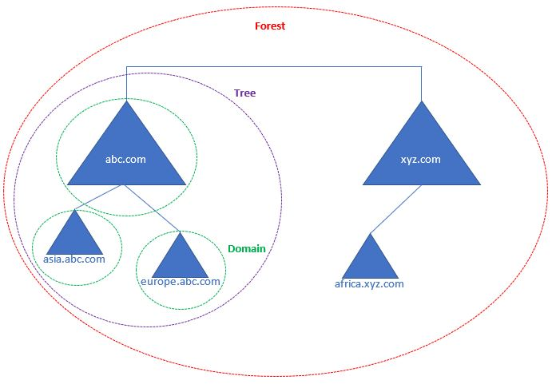
Forests
Notes:
This provides more of a visual explanation
This whole thing is considered an AD forest
Within it are two parent domains
Abc.com
Xyz.com
We can’t have a forest without trees
So, on the left you can see abc.com is parent domain of asia.abc.com and Europe.abc.com
Together they form a tree
Though xyz.com isn’t labeled as directly, same definitions apply

Slide 24
Domain Policies
Within AD, can use Global Policy Objects (GPO)
Detailed settings, covering wallpapers to security
GPOs are toggleable or definable settings
Can administer to OUs, Domains, or Forests
Allows for custom tailoring of settings
GPOs inherit hierarchically

Slide 25
GPO Exercise

Slide 26
Overview
Want to give you exposure to GPOs and the granularity they have
Download “Group Policy Settings Reference Spreadsheet for Win 10 2004”
Given a hypothetical role for a computer
Goal is to identify GPOs for this system
All conditions are business requirements

Slide 27
Securing w/ GPOs: Exercise 1
PoS on shop floor
But also, is PoS
Employees need physical access
Customers should not be able to use it
Should be physically secure
Local intranet only, no outside connection

Slide 28
Securing w/ GPOs: Exercise 2
Super duper secret machine
Formula for Coca-Cola & list of 11 Herbs & Spices
Have to be able to RDP to it over internet
System admin needs physical access
They refuse to log in / out
Stored in the playground of a Middle School
For lunch they were given a box of sugar and bootable USBs with Kali Linux

Slide 29
Securing w/ GPOs: Exercise 3
Superest duperest secret machine
Security engineer actively develops malware on this machine
Can’t let malware leak
Can’t let AV catch or analyze malware
Engineer is easily startled by noises and moving images

